Slide 1
Project Presentation on RPG Riko: The Dragon hunter
Presented by:
Aryan Sharma(2020a1r194)
Aditya Partap(2020a1r113)

Slide 2
Presentation Flow
What is Riko: The Dragon Hunter?
Inspiration
Game Design & concept
Main character
Game play
Features
User interface
A glimpse of this game
Conclusion

Slide 3
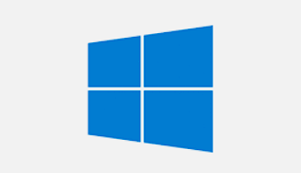
What is Riko: The Dragon hunter
A 2D Top-Down RPG made with Pygame
Platform
Other tools used
.open source asset pack of graphics

Slide 4
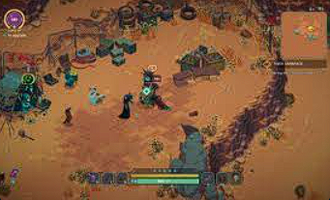
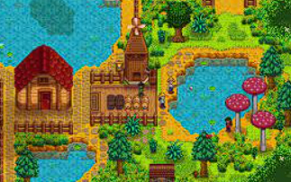
Inspiration

Slide 5
Game Design & Concept
Why I chose this project?
Game Theme
Game Assets:
1.Images
2.Audio clips

Slide 6


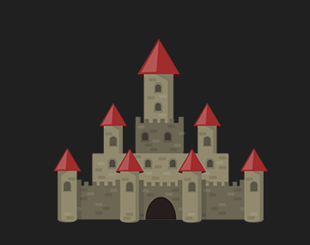
Main character
Default character Enemy character Character Castel

Slide 7
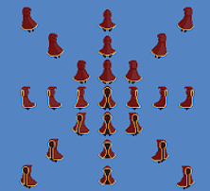
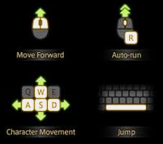
Game play
Player can move in 8 directions
Player can swing sword
Player can switch weapons
Game controls
8 Direction player movement

Slide 8
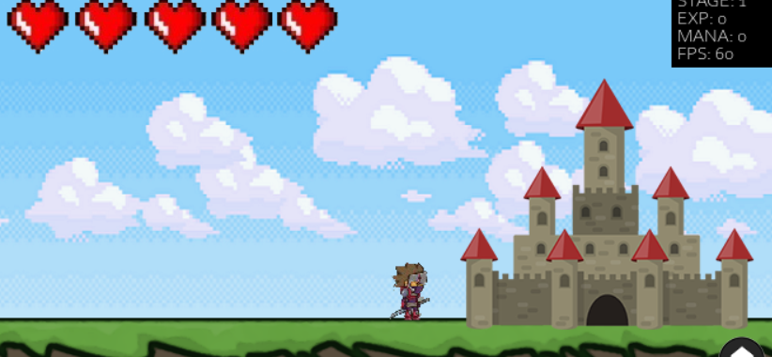
Game play(continued)
Windows

Slide 9
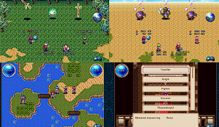
Features
Animation clips (10+)
Sound clips
3 different types of Levels
Character Menu system
Screen shaking
Player health bar

Slide 10



User interface
Death screen New game screen
Select player

Slide 11
A glimpse of the game
Riko: The Dragon Hunter

Slide 12
Thank you

